Slide 1
Security camera powered with Machine Learning for people detection for queue Data Analytics
PIP2001 Capstone Project
Review-0
CSE60
Roll Number | Student Name
20211CSE0425 | Pragnyan Prasad Satapathy
20211CSE0431 | Subhasish Mondal
20211CSE0443 | Manaswi B Patil
20211CSE0561 | Gaurav Prasad
Under the Supervision of,
Mr. Amarnath J.L
Assistant Professor
School of Computer Science and Engineering
Presidency University
Name of the Program: CSE
Name of the HoD: Dr. Asif Mohammed H.B
Name of the Program Project Coordinator: Mr. Amarnath J.L & Dr. Jayanthi. K.
Name of the School Project Coordinators: Dr. Sampath A K / Dr. Abdul Khadar A / Mr. Md Ziaur Rahman

Slide 2
Content
Problem Statement
Github Link
Analysis of Problem Statement
Timeline of the Project
References

Slide 3
Problem Statement Number: PSCS137
Organization: CISCO DevNet
Category (Hardware / Software / Both) : Software
Problem Description: Long lines at some specific time ticketing windows and services counter at Railway station, Bus stand, RTO office, Banks and other places could lead to bad services experiences. On many occasions lines are longer at specific time of day but empty/short at other times.
It would be very user if real-time and historical queue length can be made available via website or mobile app to user and facility managers. This would in long-term help deliver better experience and smarter cities. Key technical challenge to solve this problem is to identify persons in specific area.
Difficulty Level: Complex

Slide 4

Github Link
The Github link provided have public access permission.
https://github.com/Praag269/Capstone-Project.git

Slide 5






Analysis of Problem Statement
Technology Stack
Machine Learning:
Model: YOLO (You Only Look Once) for real-time object detection.
Framework: TensorFlow or PyTorch for model training and deployment.
Algorithm: CNN (Convolutional Neural Networks) for object recognition and classification.
Data Analytics: Pandas, NumPy for historical data analysis.
Web/Mobile Application:
Front-end: React (for web), React Native (for mobile).
Back-end: Node.js with Express for API development.
Database: MongoDB for queue data storage (historical and real-time).
Hosting: AWS/GCP/ for scalable cloud hosting.
API: OpenCV API for real-time video analysis.
Communication:
Socket.io for real-time data transfer to the web/mobile app.

Slide 6
Analysis of Problem Statement (contd...)
Hardware Requirements
Security Cameras:
High-definition IP cameras with 1080p or higher resolution for clear object detection.
Wide-angle lens to cover a larger queue area.
Processing Unit:
GPU: Nvidia GTX1650 or equivalent for processing video streams in real time.
CPU: Intel Core i5 or equivalent for general processing.
Storage:
Local Storage: SSD for immediate data storage.
Software Requirements
Operating System: Windows based system for better hardware compatibility.
Development Environment:
Python 3.x for building machine learning models.
VS Code or PyCharm as the development IDE.
Machine Learning Libraries: TensorFlow, PyTorch, OpenCV for real-time video analysis.
Database Management System: MongoDB for queue data storage and analytics.
Web/Mobile Development Tools: React, React Native, Node.js, Express.js.

Slide 7
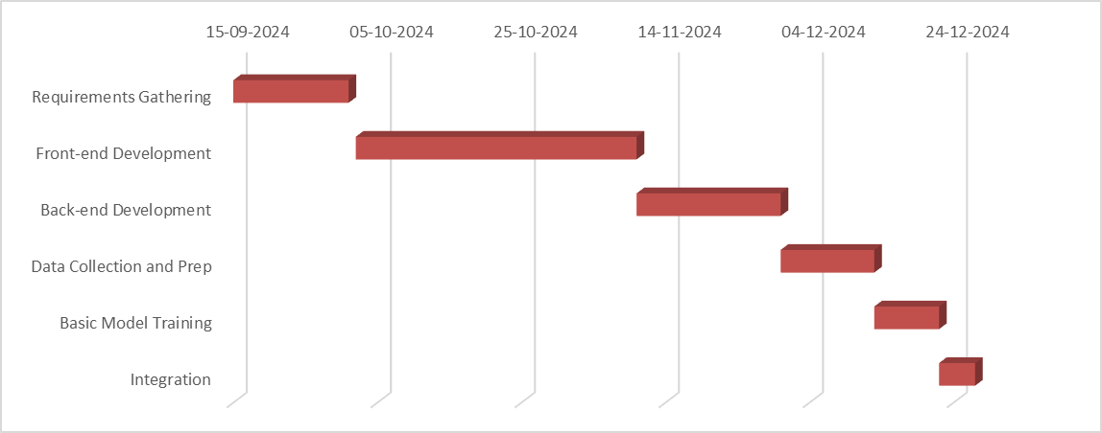
Timeline of the Project (Gantt Chart)

Slide 8
References (IEEE Paper format)
Z.-Q. Zhao, P. Zheng, S.-T. Xu, and X. Wu, "Object Detection with Deep Learning: A Review," arXiv, 2019. [Online]. Available: https://doi.org/10.48550/arXiv.1909.04150.
G. S. Maraslidis, L. Moysis, and G. F. Fragulis, "A Review of Machine Learning and Deep Learning for Object Detection, Semantic Segmentation, and Human Action Recognition in Machine and Robotic Vision," Technologies, vol. 12, no. 2, p. 15, 2024. [Online]. Available: https://doi.org/10.3390/technologies12020015.

Slide 9


